Slide 1
Estimating Passenger Volume of High-speed Rail Network in China
Boya Yu, Yunong Cao, Jiaxu Zhou, Tengfei Zheng

Slide 2
Outline
Objective
Description of Data
Method
Result
Notes:
In this presentation, I'll explain the objective and describe the data we worked with first. And Then I'll hand it to Boya to explain the method and result we got.

Slide 3
Objective
City Population
Weight of Nodes
Gravity Model
Passenger Flow
Railway
Station
Cities with Stations
Nodes Edges
Railway Network
City
Lat & Lon
Position Distance
The longest high-speed railway (HSR) network
Notes:
Here are the two sample node of the two types of data. As you can see, they are stuctured in json, and the only difference between them is that the test data does not have the information about cuisine type.
Some basic statistics were calculated during the exploratoray phase.
There are 20 cuisine types in both datasets.
The training data has about 40 thousand recipes while the test data has about 10 thousand recipe.
It is noticable that, although there are far less ingredient types in the test data, there are 2,653 ingredient types that have never appeared in the training set. We'll talk about the influence of it later.

Slide 4
Description of Data
From Wikipedia (Count : 54)
Python dictionary by manual input
Railway Network
dic[0] = {'Qinhuangdao':0, 'Huludao':138, 'Jinzhou':181, 'Panjin':250, 'Anshan':305, 'Shenyang':404}
Distance
City Name
From China 2010 Census
Counted based on the administration district of those cities.
Population Data
Geographical Information
(latitude and longitude)
ACME Mapper provided HSR train stations
Count of cities: 300
Notes:
Here are the two sample node of the two types of data. As you can see, they are stuctured in json, and the only difference between them is that the test data does not have the information about cuisine type.
Some basic statistics were calculated during the exploratoray phase.
There are 20 cuisine types in both datasets.
The training data has about 40 thousand recipes while the test data has about 10 thousand recipe.
It is noticable that, although there are far less ingredient types in the test data, there are 2,653 ingredient types that have never appeared in the training set. We'll talk about the influence of it later.

Slide 5
Method
Assumption
In the model considered only stations in big cities
Travel distance of each two stations : geographical distance
Model Specification
Added train stations as nodes in the network.
Node attributes included Track Network Dictionary and Population Data.
Added edges to the graph according to the track network.
The distances of edges were defined as the geodesic distance between the two cities.
GRAVITY MODEL for estimating passenger volume
Based on the population, distance and the track network.

Slide 6
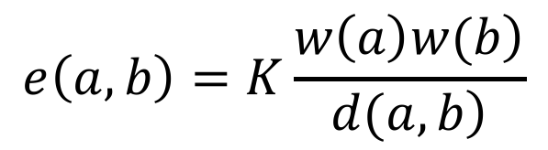
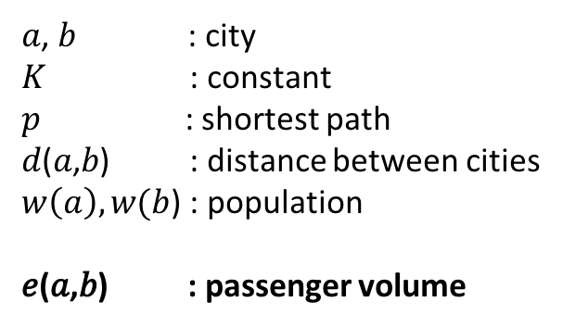
Method
GRAVITY MODEL
$$e\left(a,b\right)=K\frac{\left.w\left(a\right)w(b\right)}{\left.d(a,b\right)}$$
𝑎, 𝑏 : city
𝐾 : constant
𝑝 : shortest path
𝑑(𝑎,𝑏) : distance between cities
$w\left(a\right),w(b$) : population
𝑒(𝑎,𝑏) : passenger volume

Slide 7
Method
GRAVITY MODEL
Example of the Shanghai-Nanjing Interval
Zhenjiang
Nanjing
0
0
Changzhou
0
Wuxi
0
Suzhou
Shanghai
0

Slide 8
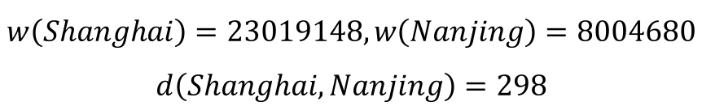
Method
GRAVITY MODEL
Example of the Shanghai-Nanjing Interval
$$w\left(Shanghai\right)=23019148,w\left(Nanjing\right)=8004680$$
$$d\left(Shanghai, Nanjing\right)=298$$
Zhenjiang
Nanjing
0
0
Changzhou
0
Wuxi
0
Suzhou
Shanghai
0

Slide 9
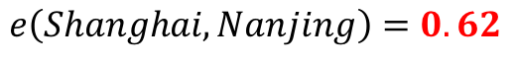
Method
GRAVITY MODEL
Example of the Shanghai-Nanjing Interval
$$e\left(Shanghai, Nanjing\right)=0.62$$
Zhenjiang
Nanjing
0
0
Changzhou
0
Wuxi
0
Suzhou
Shanghai
0

Slide 10
Method
GRAVITY MODEL
Example of the Shanghai-Nanjing Interval
$$e\left(Shanghai, Nanjing\right)=0.62$$
Zhenjiang
Nanjing
0.62
0.62
Changzhou
0.62
Wuxi
0.62
Suzhou
Shanghai
0.62

Slide 11
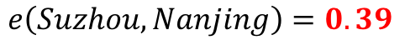
Method
GRAVITY MODEL
Example of the Shanghai-Nanjing Interval
$$e\left(Suzhou, Nanjing\right)=0.39$$
Zhenjiang
Nanjing
0.62
0.62
Changzhou
0.62
Wuxi
0.62
Suzhou
Shanghai
0.62

Slide 12
Method
GRAVITY MODEL
Example of the Shanghai-Nanjing Interval
$$e\left(Suzhou, Nanjing\right)=0.39$$
Zhenjiang
Nanjing
1.01
1.01
Changzhou
1.01
Wuxi
1.01
Suzhou
Shanghai
0.62

Slide 13
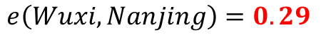
Method
GRAVITY MODEL
Example of the Shanghai-Nanjing Interval
$$e\left(Wuxi, Nanjing\right)=0.29$$
Zhenjiang
Nanjing
1.01
1.01
Changzhou
1.01
Wuxi
1.01
Suzhou
Shanghai
0.62

Slide 14
Method
GRAVITY MODEL
Example of the Shanghai-Nanjing Interval
$$e\left(Wuxi, Nanjing\right)=0.29$$
Zhenjiang
Nanjing
1.30
1.30
Changzhou
1.30
Wuxi
1.01
Suzhou
Shanghai
0.62

Slide 15

Method
GRAVITY MODEL
Example of the Shanghai-Nanjing Interval
$$Operate for all city pairs…$$

Slide 16
Method
GRAVITY MODEL
Example of the Shanghai-Nanjing Interval
Zhenjiang
Nanjing
7.59
3.78
Changzhou
13.63
Wuxi
5.01
Suzhou
Shanghai
5.64

Slide 17
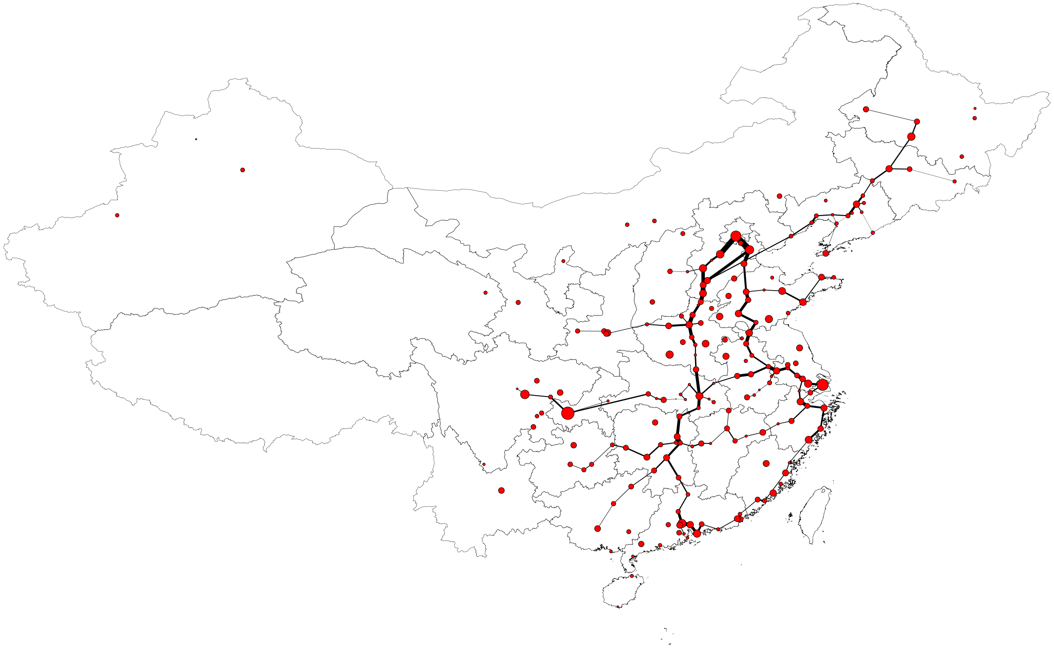
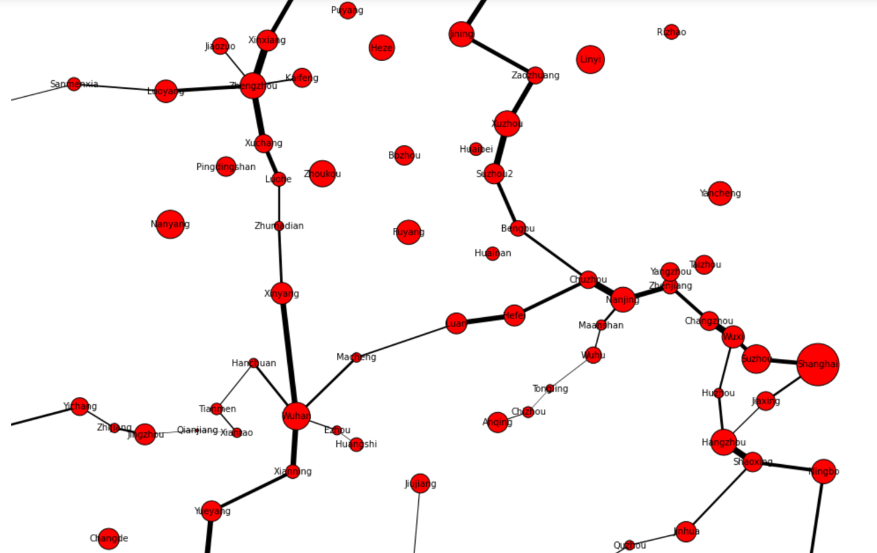
Result
Overall HSR Network
Node size: Population of Cities
Edge width: Passenger Flow
HSR Network within Yangtze River Delta and Yangtze River Downstream Plains
Node size: Population of Cities
Edge width: Passenger Flow

Slide 18
Result
Overall HSR Network
Node size: Population of Cities
Edge width: Passenger Flow
Usage and indications:
Network construction
Number of trains
Station arrangement

Slide 19
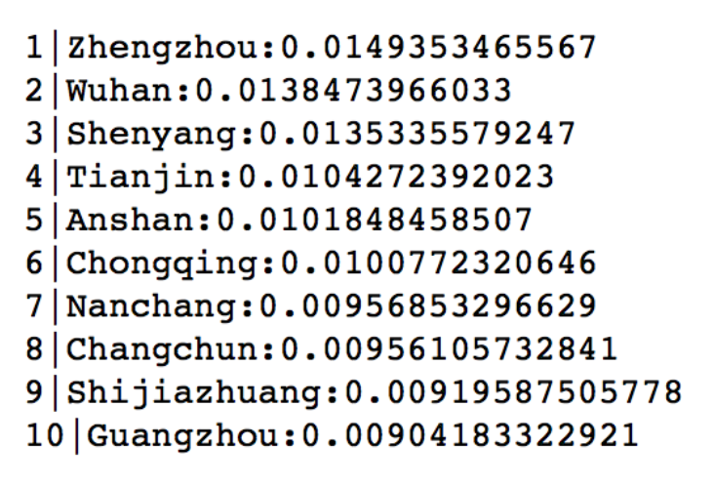
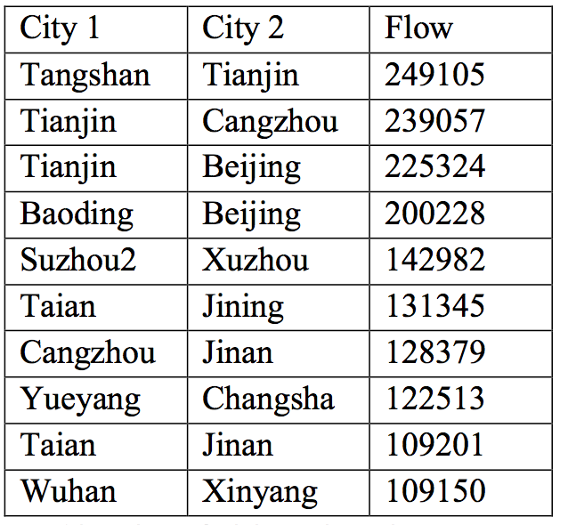
Result
Top 10 cities
with largest pagerank centrality
Top 10 city Pairs
with highest passenger flow
Most extracted cities are provincial capital cities or municipalities, indicating the high-speed railway network is being constructed surrounding and connecting major cities.

Slide 20

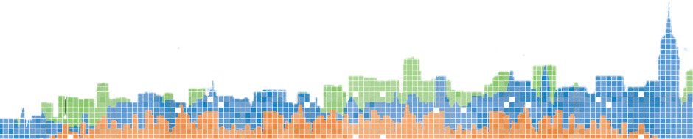
Thank You

